Slide 1
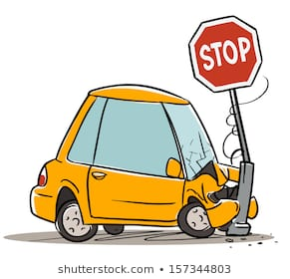
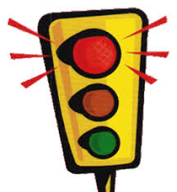
Detecting traffic rules violation

Slide 2
Represent by
NAME ROLL NUMBER
Pooja Magdum 16UIT41029XX
Vasim Mujawar 17UIT72006XX
Snehal Niprul 17UIT71009XX
Pratiksha Nawale 17UIT71008XX
Aamrapali Phule 17UIT71012XX

Slide 3

Abstract
Traffic violation detection system is effective tool to help traffic administration to monitor the traffic rule violations. It can detect traffic violations such as running red lights, over speeding, helmet wear or not , and more than two person on motorcycle .

Slide 4

Introduction
With the growth of number of vehicles, the number of traffic accidents is rapidly rising. Therefore, it is important to capture traffic violations to ensure traffic safety and reduce traffic accidents . traffic violations are the most important cause of accidents. This system can effectively capture violations. It helps drivers strengthen awareness of safety when driving and ensure smooth traffic flow.

Slide 5


Problem statement
Implement system which detects traffic rules violation.

Slide 6

Limitation of existing system
The existing system has the following limitation:
Manual work.
No mechanism for tracking jobs.
No streamline methodology/features for payment

Slide 7
objectives
The goal of the project is to automate the traffic rules violation detection system and make it easy for the traffic police department to monitor the traffic and take action against the violated vehicle owner in a fast and efficient way.
The violations such as
Sign detection
More than two people on a motorcycle i.E. Triple seat detection
Helmet wear or not

Slide 8
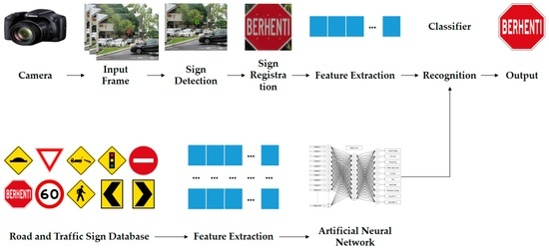
Expected input and output

Slide 9
Application
In RTO office
Motorcycle driving school
Crime reporting

Slide 10
References
Https://ieeexplore.Ieee.Org/document/8343528
Https://ieeexplore.Ieee.Org/document/7560926
Https://ieeexplore.Ieee.Org/document/8646449

Slide 11
Thank you…

